Slide 1

Teaching Non-native Speakers of English: Issues and Strategies

Slide 2

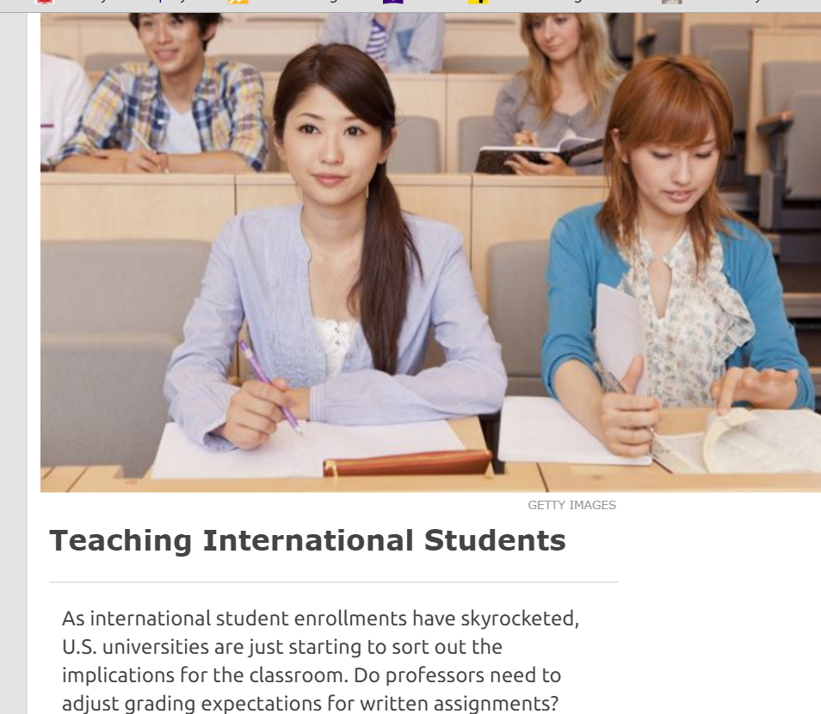
“It’s just a challenge – how to make American universities international while at the same time not compromising the quality of the education we offer,” said Jing Sun, an associate professor of political science at Denver. “It’s a common challenge to everybody.”
Inside Higher Ed (12/1/14]

Slide 3


Reasons student with adequate Toefl scores struggle
Students from cultures that have high power distance and lecture-based classes that have one or two exams have great difficulty adjusting to a lower power distance and a wider variety of assessment metrics in classes

Slide 4

The American Classroom
Many students struggle with the idea of speaking up in class, due to their ingrained notions of power distance.
Questioning the professor is seen as rude in some cultures as it implies they did not sufficiently explain the concepts

Slide 5

The American Classroom
  Adding to discussions is often viewed the same way, as the student does not feel they have yet gained enough expertise to comment, so it would impertinent of them to attempt to add anything in the presence of the professor, who is an expert.

Slide 6

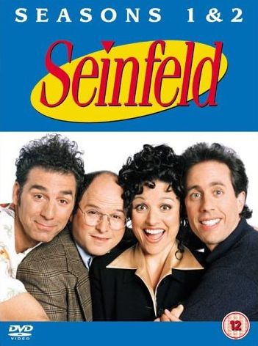
Two areas of specific concern
Discipline specific
Vocabulary
Cultural References

Slide 7
American college students have a vocabulary of approximately 20,000 words that took them 18 years to acquire.
It can be very challenging for international students to bridge this gap. Trying to understand content while taking notes can be very difficult.

Slide 8
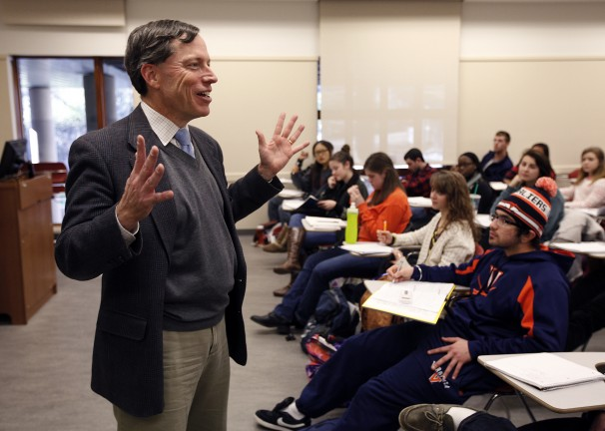
  Sometimes they struggle with pace of speech
  Frequently they have not had enough practice in listening for context and working around words they don't know, and can end up just giving up midway through a lecture

Slide 9

  Many cultures do not have any concept of learning disabilities or have a negative connotation of them
  Thus, while many of our American students come to us with an understanding of specific issues they may have, our international students are often not as fortunate.

Slide 10

  Even with proficient English, they can still spend 2-3x longer on a reading than a native speaker simply because they have to read more closely and look up words they don't know, then reread to make sure they are understanding what the author means.

Slide 11
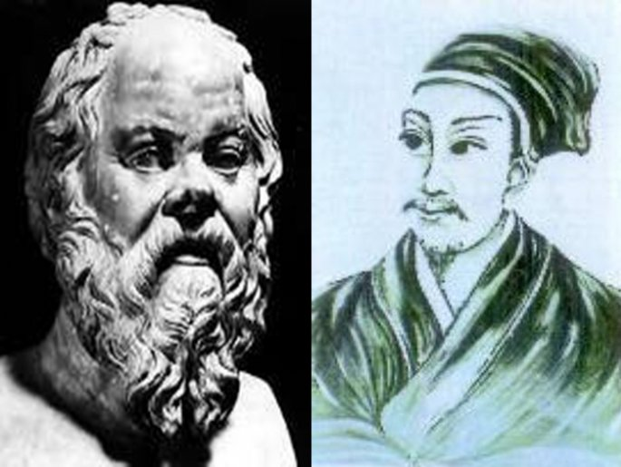
Case Study: Confucian vs. Socratic culture
“Culture provides tools, habits, and assumptions that pervasively influence human thought and behavior, and the task of learning does not escape this influence.”

Slide 12


Slide 13


“Western learners attach greater importance early in the learning process to questioning and evaluating the material presented by an instructor.”

Slide 14

“In addition, culturally Western students “tend to attach higher importance in the academic context to expressing personal hypotheses than do culturally Chinese learners” (Tweed and Darrin, 2012, p. 95).

Slide 15
First, we do not assert that culturally Chinese or culturally Western learners form homogeneous groups.
Second, genetic influences on learning approaches are neither assumed nor implied in this discussion.
Third, we are not attempting to evaluate cultures. Our goal is description, not comparative judgment.
Fourth, we do not directly address ability differences between cultural groups.
Finally, our Confucian–Socratic framework serves a descriptive function and does not presume historical causation between Confucius or Socrates and modern students in the East or West.

Slide 16
Brandeis University
Provide a lecture outline with main points to be covered to assist students in following the lecture and guiding note taking.
Define new or unfamiliar words or concepts, and provide opportunities for clarification.
Be on the lookout for jargon and try to reduce the use of idiomatic expressions and colloquialisms (e.g. “let’s cut to the chase”).
Encourage students to ask questions about things they are not sure about. They may need practice or modeling before being comfortable showing their uncertainty.
Be aware of your own speech habits; speed and clarity are particularly important.
Use transitional phrases to signal new topics (e.g. “Now, that we’ve seen…let’s turn to…”).
Consider recording your lecture and making it accessible online so students can hear it again if necessary

Slide 17
University of Denver
Talk slowly and clearly, give additional explanations for foundational concepts, clarify meanings of slang and cultural references (some students might not speak up, ask them to write down their questions and talk with them after class).
Use consistent patterns for presenting information (explain learning outcomes, what do you know about it, how does it fit with rest of material).
Allow time for brainstorming (some cultures stress reflection before speaking). Give them time to provide a considered opinion.
Be careful and aware if your content relies on precision, one mistaken definition may disrupt learning an entire concept.
Consider sending class notes/outlines ahead of time and/or allowing international students to record lectures.
Hold individual conferences/meetings with students, send follow-up emails to provide information in writing, or encourage them to use office hours.

Slide 18
University of Michigan
Use a lecture pace that allows time for note-taking, and checks for comprehension as above
Begin with a brief recap of the previous lecture, or review the overarching narrative of the course regularly
Provide an agenda or outline for each class
Post PowerPoint slides
Illustrate key points with visual material
Create study guides and study questions to help students prioritize reading material

Slide 19

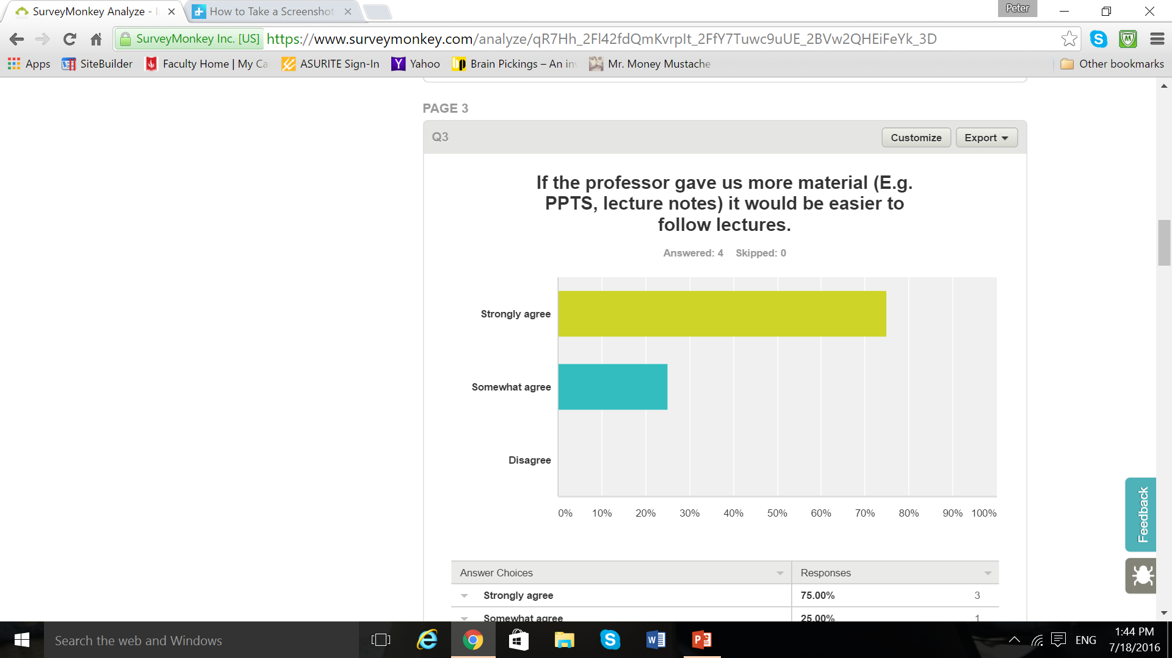

Slide 20

“Provide a lecture outline with main points to be covered to assist students in following the lecture and guiding note taking.”
“Consider sending class notes/outlines ahead of time and/or allowing international students to record lectures.”
“Provide an agenda or outline for each class/Post PowerPoint slides/illustrate key points with visual material.”

Slide 21

“Explicitly share the organization of each lecture, lab or discussion.”
--How Learning Works

Slide 22


