Slide 1
Making Students Effective Researchers
Introduction to ACRL Information Literacy Framework

Slide 2
Information Literacy
Reflective Discovery of Information
Understanding how information is produced
Using information to create new knowledge
Participating in scholarship ethically

Slide 3
ACRL Framework
Utilizing threshold concepts
  Passageways or portals to enlarged understanding or ways of thinking and practicing
Goal is to make students able to be both responsible consumers and creators of information
Creating a framework for building information literacy in students throughout their academic career.

Slide 4
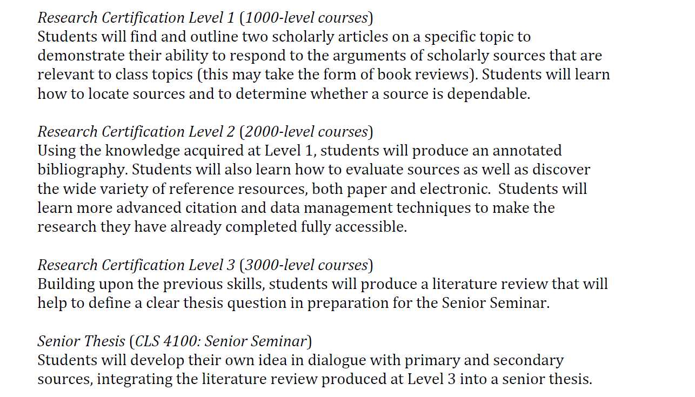
Gradual Increase toward Information Literacy

Slide 5
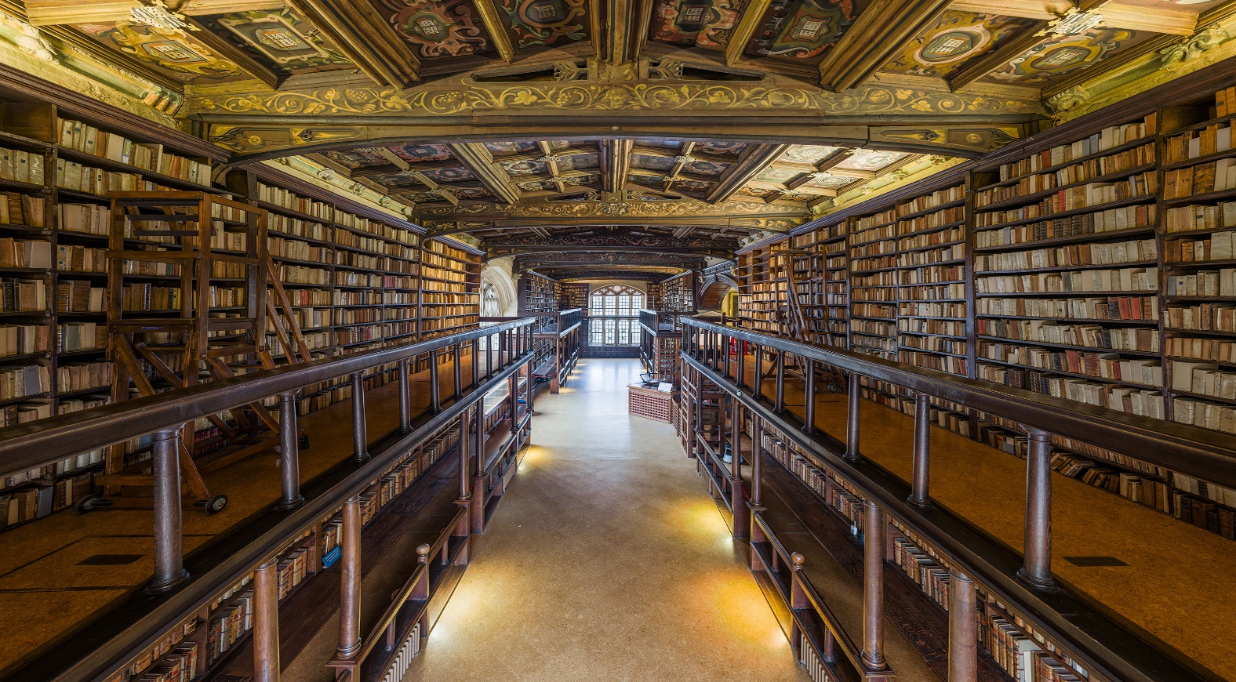
1. Authority is Constructed and Contextual
Notes:
Sources reflect their creator’s expertise and credibility
Evaluated by how the information will be used
Different communities by recognize authority differently.
We want students to know
Definite different types of authority
How to use tools to know authority
Different disciplines have different ideas on authority
Acknowledge that they are developing their own authority

Slide 6
1. Authority in Constructed and Contextual
Reflect on Student’s Expertise
How did they come up to an expertise?
How do you know someone else is an expert?
How do you evaluate someone differently when you are not an expert?

Slide 7
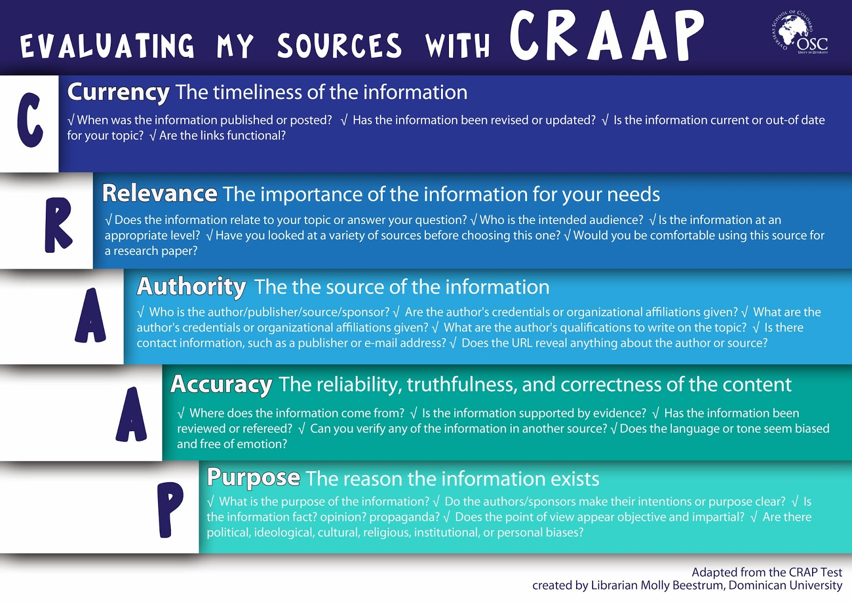
1. Authority is Constructed and Contextual
Evaluate a Source with a checklist

Slide 8

2. Information Creation is a Process
Notes:
Information is produced to convey a message
The processes of research, creation, revision, and publication my vary
We want Students to know
capabilities and constraints of information developed through various creation process
when the type of source meets their need
Information may be perceived different based on how its packaged
Formats may mean the information is static or dynamic

Slide 9
2. Information Creation is a Process
Discuss Information Life-cycle
Day 1: Online news with moment to moment updates
One Week: Longer newspaper articles, Weekly magazines
One Month: Monthly Magazine, exploratory articles
One year: Journal Articles
More than a year: Books, documentaries.

Slide 10

3. Information has Value
Notes:
Information is a commodity
Information is means of educations
Information is a way to influence
Information leads to understanding the world
Students need to know:
To give credit to the original ideas of others
Intellectual property is legal and social construct that varies by culture
Recognize issues of access or lack of access to information
Make informed decision on their own online actions.

Slide 11
3. Information has Value
Discuss Different Types of Plagiarism and why each are wrong
A student borrows a paper from a friend and copies word-for-word several paragraphs where source material is summarized and documented. When confronted by the friend, the student says that the sections she borrowed were just about cited sources, so there is no problem
A student has written a paper, the body of it paraphrases another source. There is very little of the student’s own writing in the paper, so if s/he documents the sources, nearly every paragraph will be cited.
A student buys a paper off the Internet

Slide 12

4. Research as Inquiry
Notes:
Research is iterative
To find information questions must be asked
Questions will change or develop through research
Research will lead to new questions
Our students need to know:
Formulate topics on information gaps or reexamining existing knowledge
Deal with complex searches by breaking down into simple questions
Use various research methods
Synthesize ideas gathered from multiple sources
Draw reasonable conculsions based on evidence

Slide 13
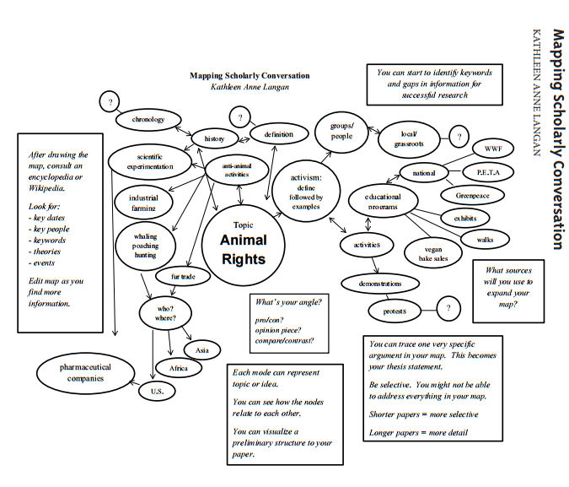
4. Research as Inquiry
Concept Map with Keywords

Slide 14
4. Research as Inquiry
Examine their own Information Seeking Behavior
Write down every question
Label it: Personal, Academic, Professional, Data
Examine behavior in class.

Slide 15

5. Scholarship as Conversation
Notes:
New insights in a given field are built upon discourse
Varied perspectives and interpretations lead to growth
Students need to know:
Cite contributing work of others in their own information production
Contribute to scholarly conversation
Critically evaluate contributions made by others
Summarize the changes in scholarly perspective over time on a particular topic within a discipline
One scholarly work does not represent the only perspective

Slide 16
5. Scholarship as Conversation
Compare Sources with Different Findings
Political, Religious, and Psychological Characteristics of Muslim Protest Marchers in Eight European Cities: Jerusalem Day 2002
Religion and Support for Suicide Attacks
“In a survey of six religions in six nations, regular attendance at religious services positively predicted a combination of willing martyrdom and out-group hostility, but regular prayer did not. ”
Ginges, J., Hansen, I., & Norenzayan, A. (2009). Religion and support for suicide attacks. Psychological Science, 20(2), 224-230.
“ results suggest that violence in support of Islamic causes cannot be understood as the expression of extreme religious beliefs or exceptional religious devotion.”
Schbley, A., & McCauley, C. (2005). Political, religious, and psychological characteristics of muslim protest marchers in eight european cities: Jerusalem day 2002. Terrorism & Political Violence, 17(4), 551-572.

Slide 17
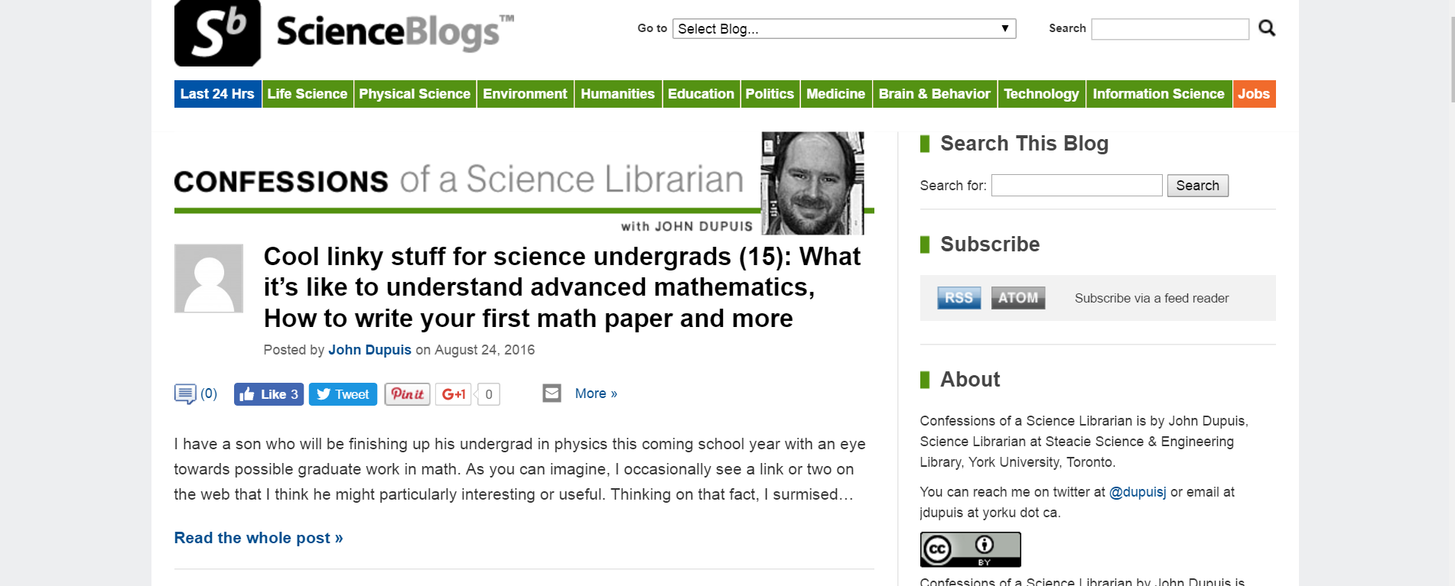
5. Scholarship as Conversation
Review Academic Blogs
Notes:
How can they be used?
Keywords
Latest research

Slide 18
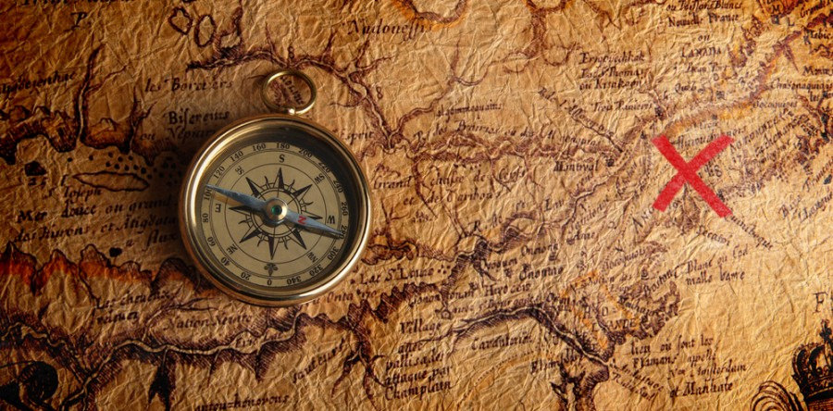
6. Searching as Strategic Exploration
Notes:
Mental Flexibility is required
Search process is often nonlinear and iterative
Requires evaluation of a range of information sources
Students should know:
Determine initial scope to meet need
Identified people who would be interested in the topic
Match information needs and search strategies to search tools
Refine needs and strategies based on search results
Understand how databases are organized
Using different search languages (subject headings, keywords, etc)

Slide 19
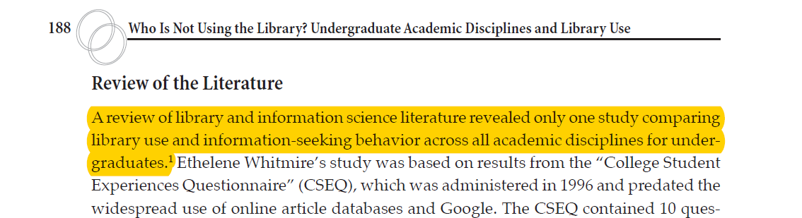
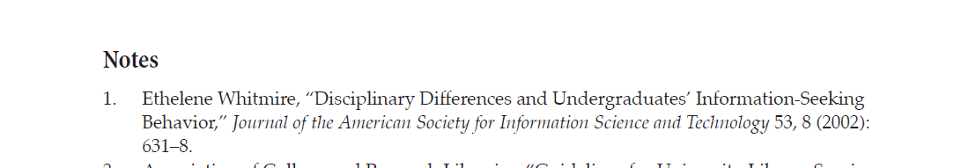
6. Searching as Strategic Exploration
Citation Chasing

Slide 20
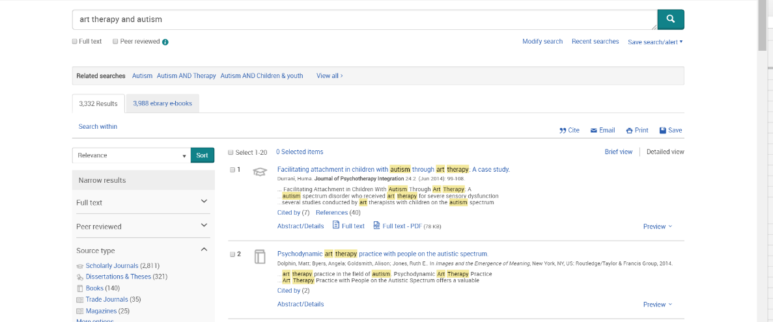
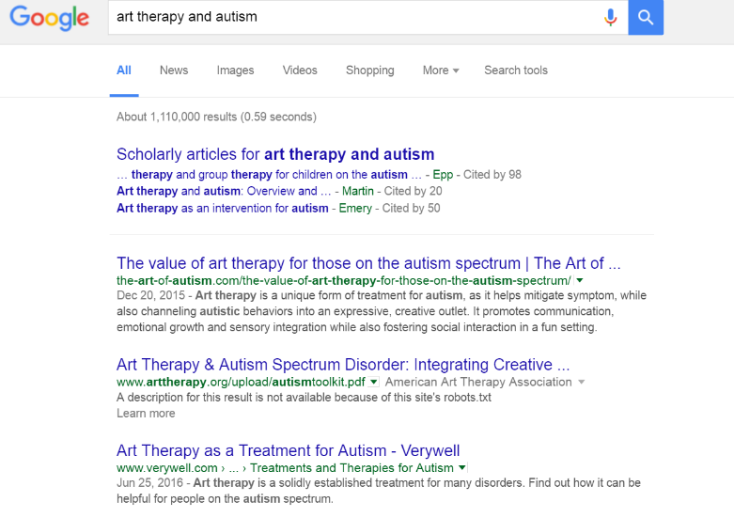
6. Searching as Strategic Exploration
Compare Searches in Database Vs. Google

